Slide 1

ELECTRONIC/GADGET STORE POS
GROUP 22

Slide 2
BUSINESS CASE
PROBLEM STATEMENT
01
PROPORSED SOLUTION
02
EXPECTED BENEFITS
03
BUSINESS VALUE
04
COST CONSIDERATIONS
05

Slide 3
1. PROBLEM STATEMENT
Electronics retail businesses face challenges such as:
Inaccurate inventory tracking
Slow checkout process
Poor reporting and sales analysis
Lack of centralized sales records
Manual record-keeping in physical books

Slide 4
2. Proposed Solution
Develop a Point of Sale (POS) system that automates:
Sales processing
Inventory updates
Report generation
User management

Slide 5
3. Expected Benefits
Faster transaction processing
Real-time inventory updates
Accurate sales reporting
Improved decision-making
Reduced operational errors

Slide 6
4. Business Value
The system will:
Increase operational efficiency
Improve customer satisfaction
Reduce losses from stock mismanagement
Support business growth through better analytics

Slide 7
5. Cost Considerations
Development time and effort = 7-8 weeks
Deployment infrastructure = vs code, next.js, firebase and vercel.
Maintenance and upgrades
Total system cost = K3,500
Conclusion: The long-term operational benefits outweigh development costs.

Slide 8
Iteration plan
ITERATION 1 – (INCEPTION PHASE)
01
FUTURE ITERATIONS
02

Slide 9
Iteration 1 – Inception (The is the Current Phase)
OBLECTIVES:
Define project scope
Identify stakeholders
Develop high-level requirements
Identify major risks
Prepare initial project documentation

Slide 10
DELIVERABLES:
Business case
High-level requirements
Use case list
Risk list
Iteration plan
DURATION:
2 weeks

Slide 11
Future Iterations
ELABORATION PHASE:
Refine requirements
Develop system architecture
Create UML diagrams
Build architectural prototype
Build an initial working prototype of the Gadget store POS for refinement in the construction phase

Slide 12
CONSTRUCTION PHASE:
Implement core modules:
Sales processing
Inventory management
Reporting
Perform system testing
DEPLOYMENT PHASE:
Deployment
User training
System evaluation

Slide 13

High-Level Requirements
FUNCTIONAL REQUIREMENTS
01
NON – FUNCTIONAL REQUIREMENTS
02

Slide 14
Functional Requirements
The system shall allow a cashier to process sales transactions by scanning the barcode and allowing online payment.
The system shall update inventory automatically after each sale.
The system shall allow managers to add, edit, and delete products.
The system shall generate daily, weekly, and monthly sales reports.
The system shall manage user accounts and roles (Admin, Manager, Cashier).
The system shall allow product search by name, category, or barcode.
The gadget store system should be able to communicate with other systems.
The system shall allow staff to remove discontinued products from the inventory.
The system shall allow the admin to create, disable or remove user(cashier) accounts.

Slide 15
Non-Functional Requirements
The system shall process transactions within 2 seconds.
The system shall ensure data security through authentication and role-based access control.
The system shall be user-friendly and easy to learn.
The system shall maintain data integrity and prevent data loss.
The system shall be scalable for future expansion.
The system should be able to work both online (to send reports and summaries of gadget stock levels to the cloud) and offline (during network interruption periods - so that gadget sales continue.)

Slide 16
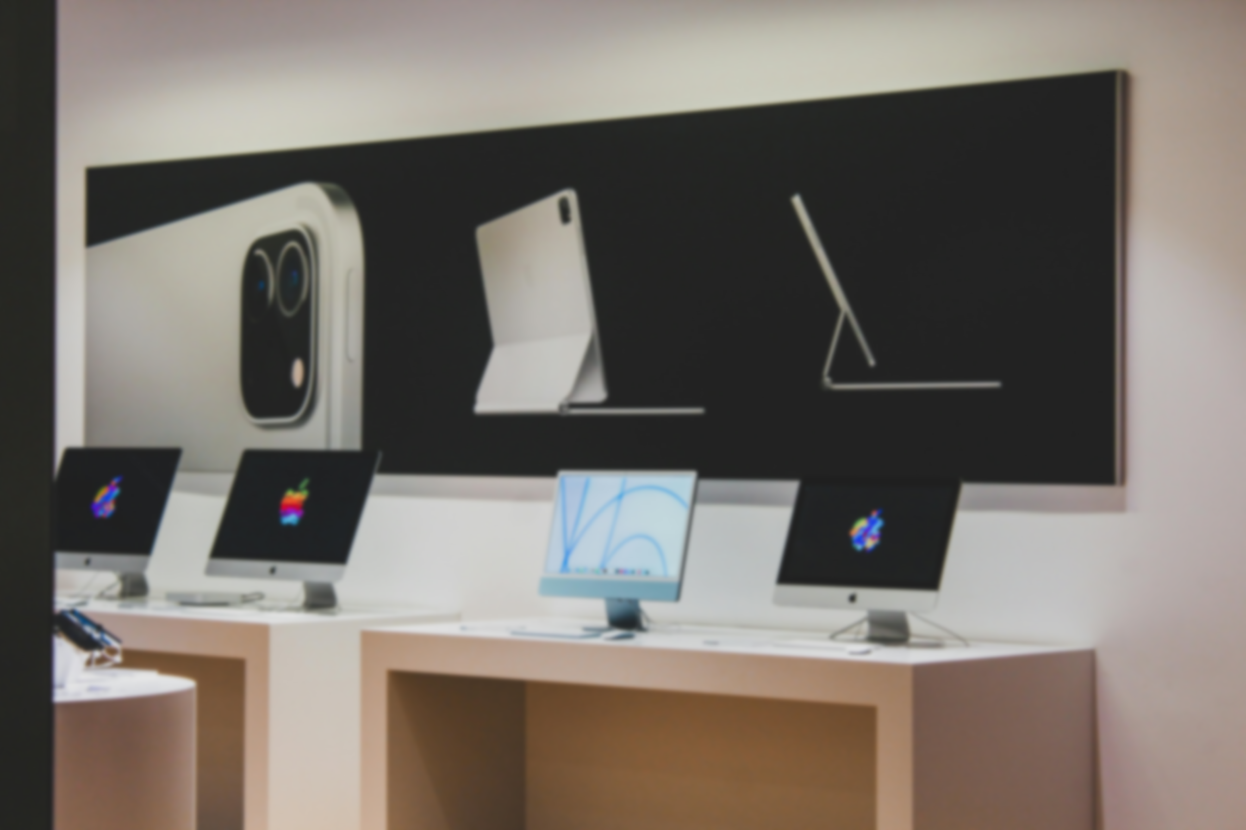
HIGH – LEVEL USE CASES
1. Process Sale
Primary Actor: Cashier
Description: The cashier scans products, calculates total amount, processes payment, and prints receipt.
2. Manage Inventory
Primary Actor: Manager
Description: The manager adds, updates, or removes products from the system.

Slide 17
3. Generate Sales Report
Primary Actor: Manager
Description: The manager views sales summaries and performance reports.
4. Manage Users
Primary Actor: Admin
Description: The admin creates and manages user accounts and assigns roles.

Slide 18
5. Search Product
Primary Actor: Cashier
Description: The cashier searches for products by name, category, or barcode.
6. Print Receipt
Primary Actor: Cashier
Description: The system generates and prints a receipt after a successful transaction.

Slide 19
7. Process Payment
Primary Actor: Cashier
Description: The cashier selects payment method and comfirms payment.
8. Apply Discount
Primary Actor: Cashier
Description: The cashier applies authorized discounts during checkout.

Slide 20
Risk List and Feasibility Analysis
RISK LIST
01
FEASIBILITY ANALYSIS
02

Slide 21
RISK LIST
TECHNICAL RISKS
R1: Lack of experience with POS system architecture. R2: Integration challenges between modules (sales, inventory, reporting). R3: Data security vulnerabilities. R4: Incorrectly scanning of the product or gadget barcode.
BUSINESS RISKS
R4: System may not meet stakeholder expectations. R5: Budget or infrastructure limitations.

Slide 22
FEASIBILITY ANALYSIS
TECHNICAL FEASIBILITY
The project is technically feasible using modern programming frameworks and databases.
ECONOMIC FEASIBILITY
Development costs are manageable using the stipulated amounts and the current growing digital economy(have to adapt).
OPERATIONAL FEASIBILITY
Store staff can be trained easily due to the system’s user-friendly design.

Slide 23
The End!

